Slide 1
DAH2F3 Perencanaan Sumber Daya Perusahaan
Minggu ke-8: Management Accounting/Controlling
P r o d i D 3 K o m p u t e r i s a s i A k u n t a n s i F I T , U n i v e r s i t a s T e l k o m

Slide 2
Agenda
Lesson: SAP R/3 Accounting
Accounting Foundation
Reference:
SAP. (2006). SAP01: SAP Overview. SAP AG.
Financial Accounting
Management Accounting

Slide 3
Unit 5: SAP R/3 Accounting: Financial and Management Accounting
Unit Overview
Two functional areas within the mySAP Financials solution: Financial Accounting and Management Accounting
Unit Objectives
Different between organizational element and master data
Illustrate the integration between Financial Accounting and other SAP module
Describe how to view Chart of Account
Describe how to create payment, view a general ledger transaction, and view a bank balance

Slide 4
Lesson: Management Accounting
Lesson Overview
Foundation of mySAP Financials Management Accounting b providing overveiw of the Controlling and Enterprise Controlling
Lesson Objectives
Define organization elements and master data in relation to mySAP Financials’ Management Accounting: Controlling and Enterprise Controlling
Define the component of Controlling and Enterprise Controlling
Illustrate the integration between Controlling and other SAP application components area
Crate cost center master record
View a cost center report

Slide 5
Pertanyaan Pendahuluan
Apakah perbedaan dari FI dan CO?
Sebutkan dan jelaskan OE di FI dan CO?
Terdapat beberapa istilah pengelolaan biaya (Cost)di CO: Cost Center Accounting, Internal Order, Activity Based Costing, Product Cost Controlling. Apakah perbedaan dari keempat istilah tersebut.
Terdapat beberapa istilah pengelolaan profit di CO: Profitabiilty analysis dan Profit Center Accounting. Apakah perbedaan dari istilah tersebut.
Jelaskan integrasi antara CO dengan production planning (PP) & CO dengan Sales and Distribution (SD)

Slide 6
Controlling (CO)
CO represents the internal accounting perpective
Provide information for managers
In charge with directing and controlling organizational’s operation
CO
Cost
Revenue
CO provide managerial accounting information without being limited to legal requirement

Slide 7
FI v.s. CO
FI → Accounting: Financial
FI untuk hal-hal/pihak-pihak yang bersifat eksternal, hasilnya berupa laporan keuangan, neracasaldo, dan laba-rugiuntuk supplier, customer, bank, stakeholder, dll
CO → Management Accounting
untuk hal-hal/pihak-pihak yang bersifat internal, berupa laporan untuk manager

Slide 8
Master Data
mySAP Financial Controlling carries out cost and revenue element accounting.
Cost and revenue element accounting records and groups the cost incurred during particular settlement period.
Posting relevant to cost accounting contain the cost or revenue elements involved and specific locations and reasons for the cost.
SAP R/3 system uses Controlling Object for account assignment.
“Controlling Object” form the master data of CO.
Controlling Object for account assignment = cost center, orders, project, business process, and various cost object such as sales order.

Slide 9
Organizational Element
Controlling Area
Company Code
Profit Center
Company Code
Profit Center
System for Cost accounting purpose
Independent legal entity
By product, geographical factors, or function
Profit Center
Notes:
Controlling area represent a closed system used for cost accounting purposes within organization.
Profit center = management-oriented organizational unit used for internal controlling purposes. Divide into profit center, you can analyze area responsibility and delegate responsibility.
Profit center can be divide according to products (products lines, division), geographical factors(region, offices, or product sites), or functions (production, sales)

Slide 10
Organizational Element
1 Controlling Area = 1 or more Company codes
that may use different currency.
But,
Must use the same operational Chart of Account (CoA) and fiscal year.
Notes:
Controlling area represent a closed system used for cost accounting purposes within organization.
Profit center = management-oriented organizational unit used for internal controlling purposes. Divide into profit center, you can analyze area responsibility and delegate responsibility.
Profit center can be divide according to products (products lines, division), geographical factors(region, offices, or product sites), or functions (production, sales)

Slide 11
Component of Management Accounting
1. “Enterprise Controlling” (EC)
Efficient controlling aids are needed to manage the company as a unit.
2. “Controlling “ (CO)
Facilitate coordination, monitoring, and optimization of all processes in an organization.
Process = consumption of production factors and the service provided by an organization.

Slide 12
Component of Management Accounting
1. “Enterprise Controlling” (EC)
Tujuan dari modul EC adalah untuk memberikan akses bagi Enterprise Controller mengenai informasi:
Kondisi keuangan perusahaan- Hasil dari perencanaan dan pengendalian perusahaan,
Investasi,
Maintenance dari aset perusahaan,
Akuisisi dan pengembangan SDM perusahaan,
Kondisi pasar yang berkaitan dengan pengambilan keputusan, seperti ukuran pasar, competitor performance, Faktor-faktor struktural dari proses bisnis, seperti struktur produksi, struktur biaya, financial accounting dan profitability analysis.

Slide 13
Component of Management Accounting
2. “Controlling “ (CO)
Tujuan dari modul CO adalah untuk mendukung empat kegiatan operasional:
Pengendalian capital investment,
Pengendalian aktivitas keuangan perusahaan,
memonitor dan merencanakan pembayaran,
Pengendalian pendanaan terhadap procurement,
pengadaan dan penggunaan dana di setiap area,
Pengendalian biaya dan profit berdasarkan semua aktivitas perusahaan

Slide 14
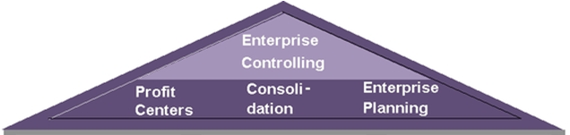
Component of Management Accounting
1. “Enterprise Controlling” (EC)
Efficient controlling aids are needed to manage the company as a unit.
Key Capabilities dari “EC”
Profit Center Accounting (EC-PCA)
Consolidation

Slide 15
Component of Management Accounting
1. “Enterprise Controlling” (EC)
Profit Center Accounting (EC-PCA)
Evaluate the profit or loss of individual , independent areas within organization. (Untuk analisa untung/rugi dari sebuah organizational unit-department)
You can analyze the area of responsibility and delegate responsibility to distributed units.
It display statistical accounting component. Key figure you can display: Return on Investment (ROI), Working Capital, Cash Flow on a profit center.
Notes:
Return on Investment (ROI) A performance measure used to evaluate the efficiency of an investment or to compare the efficiency of a number of different investments. ROI = (gain from investment - cost of investment) / cost of investment
Working capital is how much in liquid assets that a company has on hand. WC = the current assets minus the current liabilities.

Slide 16
Component of Management Accounting
1. “Enterprise Controlling” (EC)
b. Consolidation
Consolidate financial data both external (legal) and internal (profit center) accounting perspective.
Currency translation, inter-unit elimination, and consolidation of investment

Slide 17
Component of Management Accounting
1. “Enterprise Controlling” (EC)
Efficient controlling aids are needed to manage the company as a unit.
2. “Controlling “ (CO)
Facilitate coordination, monitoring, and optimization of all processes in an organization.
Process = consumption of production factors and the service provided by an organization.

Slide 18
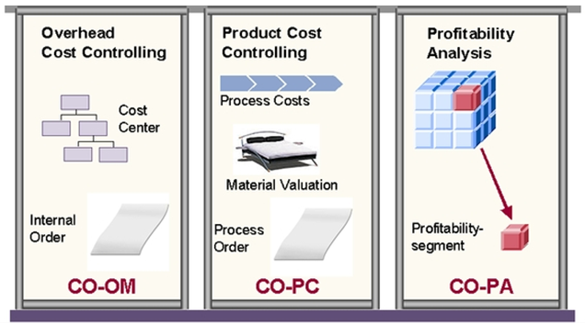
Component of Management Accounting
2. “Controlling “ (CO)
Facilitate coordination, monitoring, and optimization of all processes in an organization.
Process = consumption of production factors and the service provided by an organization.

Slide 19
Component of Management Accounting
2. “Controlling “ (CO)
Key Capabilities dari “CO”
Overhead Cost Controlling (CO-OM)
Cost Center Accounting
Internal Order
Activity Based Costing (ABC)
Product Cost Controlling (CO-PC)
Profitability Analysis (CO-PA)

Slide 20
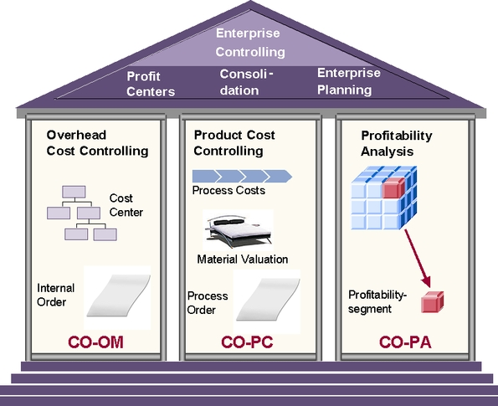
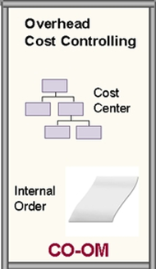
Component of Management Accounting
2. “Controlling “ (CO)
Overhead Cost Controlling (CO-OM)
The main purpose is to take cost that cannot be assignedd directly to the goods or services of a company an allocate the as far as is possible according to their cause.
(fokus pada mengalokasikan biaya yang tidak bisa secara langsung dikenakan pada barang/jasa)
Notes:
Biaya Bahan Penolong
Biaya Tenaga Kerja Penolong
1. Biaya depresiasi, semua aktiva tetap (kecuali tanah) yang dimiliki dan digunakan oleh perusahaan untuk beroperasi, akan semakin menyusut nilainya bersamaan dengan berjalannya waktu. Sebab-sebab terjadinya penyusutan itu bisa bermacam-macam seperti : susut karena dipakai, pengaruh iklim, menjadi tua dan sebagainya. 2. Biaya reparasi dan pemeliharaan berupa biaya suku cadang, biaya bahan habis pakai dan harga perolehan jasa dari pihak luar perusahaan untuk keperluan perbaikan dan pemeliharaan emplasemen, perumahan, bangunan pabrik, mesin - mesin dan kendaraan. 3. Biaya listrik, biaya overhead ini merupakan kewajiban perusahaan kepada pihak luar dalam proses pembayaran. 4. Biaya kesejahteraan karyawan, bagian dari kewajiban perusahaan memberikan tunjangan kehidupan karyawan atas pengabdian terhadap perusahaan. 5. Biaya bank, adalah biaya atau bagian dari kewajiban perusahaan kepada pihak luar dan biaya itu sendiri bukan merupakan bagian integral dari produksi. 6. Biaya pengelolaan limbah, biaya ini pada umumnya hanya memberikan jasa pelayanan kepada suatu proses produksi. 7. Biaya training dan transportasi, merupakan biaya-biaya yang terjadi untuk melaksanakan kegiatan pemasaran produksi. 8. Biaya asuransi, biaya yang dikeluarkan perusahaan untuk menjamin perusahaan bila terjadi hal-hal yang tidak diinginkan seperti : kebakaran

Slide 21
Component of Management Accounting
2. “Controlling “ (CO)
Overhead Cost Controlling (CO-OM)
Component that helps you to plan, allocate, control, and monitor overhead in your organization.

Slide 22
Component of Management Accounting
2. “Controlling “ (CO)
Overhead Cost Controlling (CO-OM)
You can develop standards that allows you to control cost and valuate internal activities.
You can examine the origin of cost in the functional area of an enterprise.

Slide 23
Component of Management Accounting
2. “Controlling “ (CO)
Overhead Cost Controlling (CO-OM)
Cost Center Accounting
Internal Order

Slide 24
Component of Management Accounting
2. “Controlling “ (CO)
Overhead Cost Controlling (CO-OM)
Cost Center Accounting
Is used to determine where the cost incurred in your organization.
Menghasilkan laporan pengeluaran (cost reports)
Cost Center bisa berupa departemen (organizational unit) yang dikepalai oleh Manager pada suatu lingkup tertentu
Contoh lingkup: Marketing, Purchasing, HR, Finances, dsb
Notes:
Bagian apa yang muncul biaya? Disitu dibuat cost center

Slide 25
Component of Management Accounting
2. “Controlling “ (CO)
Overhead Cost Controlling (CO-OM)
Cost Center Accounting
You should structure cost center so that they represent area of responsibility,
So a given person manages the cost in that subarea.
Notes:
Bagian apa yang muncul biaya? Disitu dibuat cost center

Slide 26
Component of Management Accounting
2. “Controlling “ (CO)
Overhead Cost Controlling (CO-OM)
Cost Center Accounting
Studi Kasus: Politeknik Telkom.
Unit mana saja yang mengeluarkan biaya? Sebutkan 1 biayanya!
Setiap Unit yang mengeluarkan biaya dapat di-set sebagai Cost Center plus dengan orang penanggung jawabnya.
Notes:
Bagian apa yang muncul biaya? Disitu dibuat cost center

Slide 27
Component of Management Accounting
2. “Controlling “ (CO)
Overhead Cost Controlling (CO-OM)
Cost Center Accounting
1 cost center = 1 Controlling Area
= 1 Company Code
Reconcile external and internal accounting
= 1 Business Area
= 1 Profit Center
Analysis process
Notes:
Bagian apa yang muncul biaya? Disitu dibuat cost center

Slide 28
Component of Management Accounting
2. “Controlling “ (CO)
Overhead Cost Controlling (CO-OM)
Cost Center Accounting
How many minimum cost center in 1 controlling area?
1 Cost Center
(standard hierarchy)

Slide 29
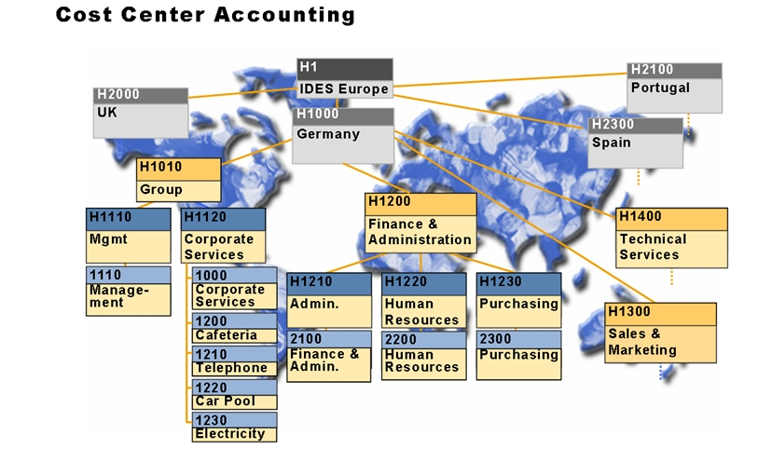
Component of Management Accounting
2. “Controlling “ (CO)
Overhead Cost Controlling (CO-OM)
Cost Center Accounting

Slide 30
Component of Management Accounting
2. “Controlling “ (CO)
Overhead Cost Controlling (CO-OM)
Internal Order
Used to plan, collect and settle the cost of internal job and tasks.
Internal order category:
Standard Order
Productive Order
Untuk memantau biaya yang muncul (cost) dari suatu job, service atau task
Suatu job/service/task bisa diberi anggaran, lalu dipantau oleh Internal Order

Slide 31
Component of Management Accounting
2. “Controlling “ (CO)

Slide 32
Component of Management Accounting
2. “Controlling “ (CO)
Activity Based Costing (ABC)
Cost accounting method to monitor cost by business process rather then cost center.
Salah satu metode akuntansi biaya (penentuan HPP) untuk memantau biaya berdasarkan bisnis proses/aktivitas yang terjadi,
Kegunaan: untuk pemantauan biaya- biaya yang berlebih/tidak efisien dan untuk memantau unit-unit yang tidak efisien

Slide 33
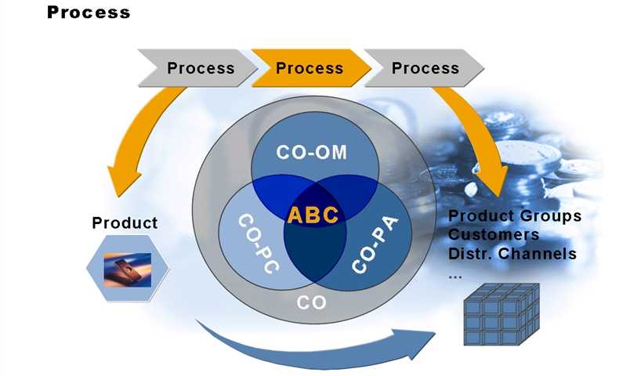

Slide 34
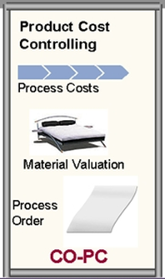
Component of Management Accounting
2. “Controlling “ (CO)

Slide 35
Component of Management Accounting
2. “Controlling “ (CO)
Product Cost Controlling (CO-PC)
Component that manage cost related to the manufacturing process and the rendering of service.
Tujuan untuk mengatur biaya proses produksi
It enables you to calculate the minimum price at which a product can be profitability marketed.
Menghitung biaya produksi untuk menentukan harga jual produk yang optimal untuk dijual ke pasar
Notes:
Menghitung biaya produksi untuk menentukan harga jual produk yang optimal untuk dijual ke pasar

Slide 36
Any Question?

Slide 37
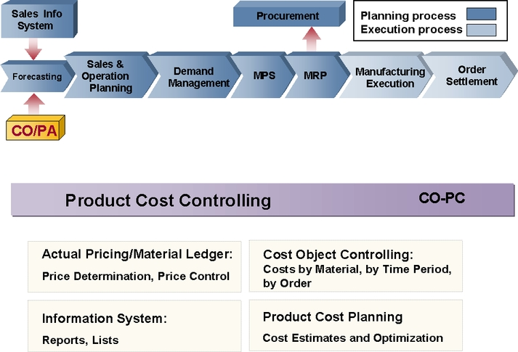

Slide 38
Component of Management Accounting
2. “Controlling “ (CO)
Product Cost Controlling (CO-PC)
CO-PC uses information from Overhead Cost Controlling (CO-OM) component to calculate such cost as
labor, machine or factory overhead
And provide information to Profitability Analysis (CO-PA).

Slide 39
Component of Management Accounting
2. “Controlling “ (CO)
Product Cost Controlling (CO-PC)
Tools:
Product Cost Planning
Cost Object Controlling
Actual Costing
Information System

Slide 40
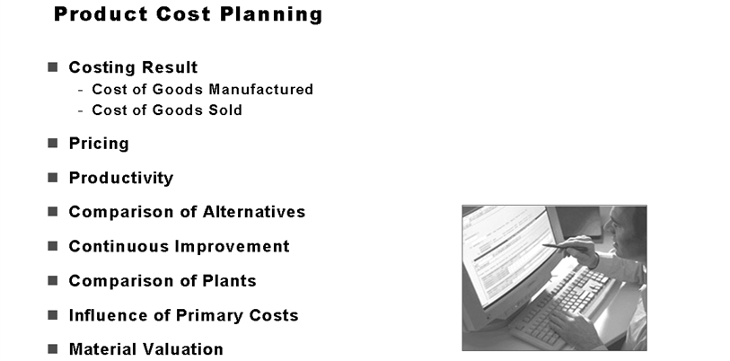

Slide 41
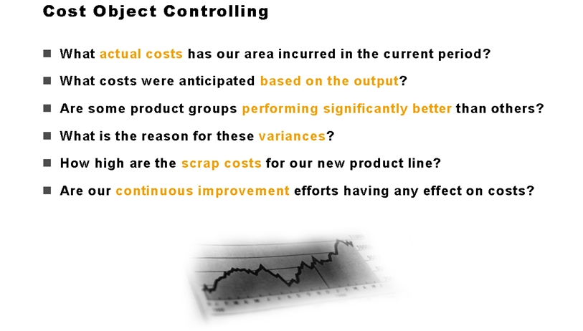

Slide 42
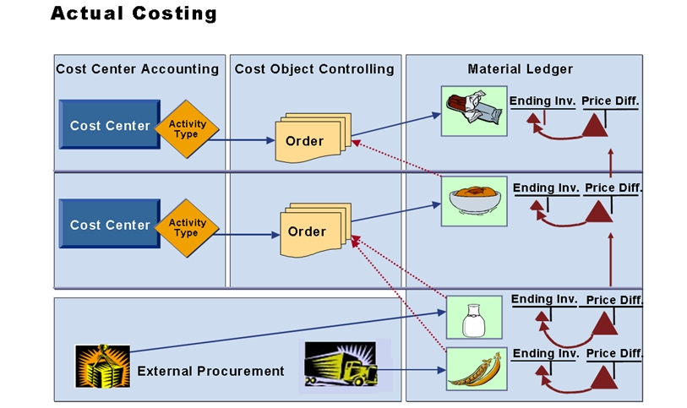

Slide 43
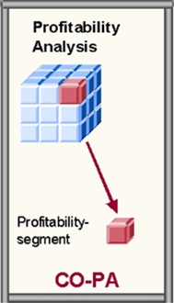
Component of Management Accounting
2. “Controlling “ (CO)

Slide 44
Component of Management Accounting
2. “Controlling “ (CO)
Profitability Analysis (CO-PA)
External view of your profitability.
CO-PA allows you to monitor and analyze contribution of your market segment and units, structure according to products, customer order, and summarization of these and other define characteristics.
Analisa untung/rugi dari sebuah organizational unit berdasarkan segmen market / karakteristik tertentu
Menyediakan data untuk penentuan harga jual, sasaran pembeli dan pemilihan jalur distribusi produk

Slide 45
Component of Management Accounting
2. “Controlling “ (CO)
Profitability Analysis (CO-PA)
Profit Center Accounting (EC-PCA)
Internal view of your profitability.
Responsibility characteristics is balancing COSTS and REVENUE
You can structure profit center according to region (branch offices, plants), function (production, sales), or product (product ranges, division).

Slide 46
Component of Management Accounting
2. “Controlling “ (CO)
Profitability Analysis (CO-PA)
Profit Center Accounting (EC-PCA)
Studi Kasus: Politeknik Telkom.
Unit mana saja yang menghasilkan pendapatan? Sebutkan 1 pendapatannya!
Setiap Unit yang menghasilkan pendapatan dapat di-set sebagai Profit Center plus dengan orang penanggung jawabnya.

Slide 47
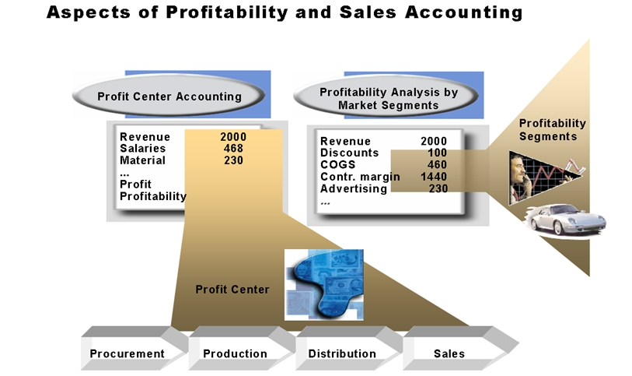

Slide 48
RESUME
“EC”
“CO”

Slide 49
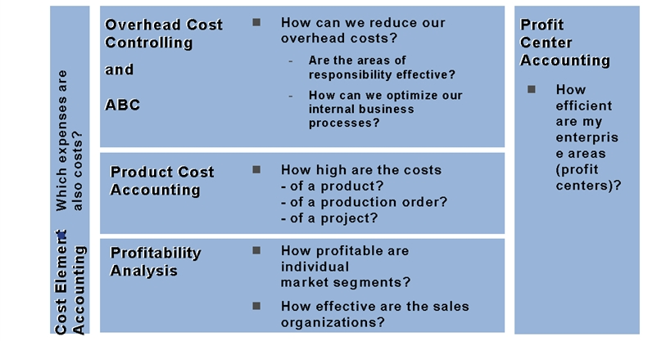
RESUME

Slide 50
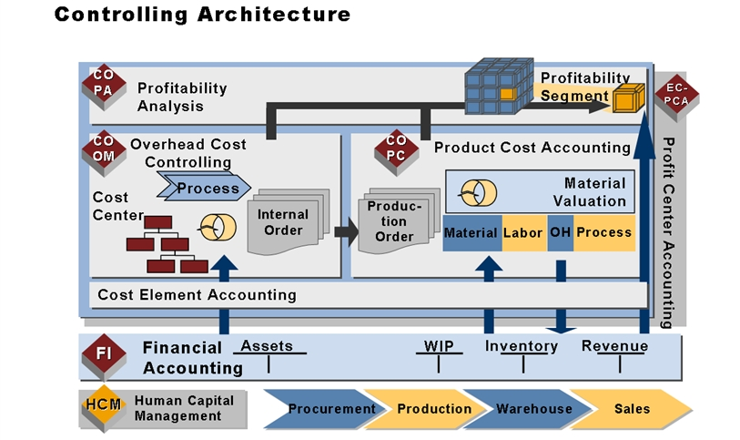
RESUME

Slide 51
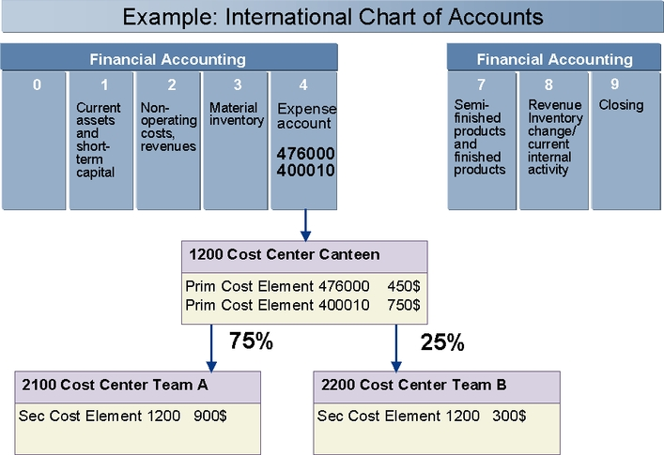
Posting in Controlling

Slide 52
Integration SAP R/3
Application component which can transfer data to Cost Center Accounting automatically.
Financial Accounting (FI)
Assets Accounting (FI-AA)
Material Management (MM)
Material Consumption
Production Planning (PP)
Personnel Administration and Payroll (PA)
Sales and Distribution (SD)
Source of Revenue postings to CO/EC via Billing Document

Slide 53

End of This Session

